Slide 1

TruRisk Life & LTD
Clinical Factors
Overview Presentation

Slide 2
Challenges
Risk selection:
  Manual rates—little discrimination.
  Experience - little credibility for small and medium-sized groups.
Competition—wild variability in pricing
Rapid and profitable organic growth is almost impossible with traditional underwriting in today’s market.

Slide 3
Adding a Clinical Dimension to Group Risk Assessment
Use additional information (all medical claims).
Forecast claim cost more accurately using proprietary Bayesian clinical models.
Maximize the distribution system—review all groups in medical plan then quote on groups with the greatest profit potential.
Patented process that our competitors lack.

Slide 4
More Profitable
Underwriting
Evaluate risk and target favorable groups using Clinical Statistical Models:
  Provide more accurate pricing of Life and LTD for medical customers.
  Lower and more stable overall loss ratio.
Lower future risks—target high risk Life and LTD employees for medical management.

Slide 5
Evaluating Life and LTD Risk
Medical claims and eligibility data required for cases to be underwritten.
Medical and Life/LTD claims do not need to be linked at the person or group level for model development - key insight allowing for use of Bayesian Models.
Life and LTD use Different Models focusing on risks specific to each product.
Compare clinical risk to demographic and/or experience risk. Calculate clinical factor - clinical/demographic ratio.

Slide 6
Clinical Statistical Models
Benefits of conventional medical underwriting without the cost or intrusion - based on a group’s encrypted medical claims and eligibility data.
Far greater range in the person-level estimate of incidence rates.
Direct estimate of future risk—forward looking.

Slide 7
Chain of Events for Disability/Death
No Clinical Condition Condition Develops
Diagnosis and Treatment (usually) Disability/Death
Probability
Lung CA
=.001
Probability LTD
Given Lung CA
=.09
Female 45-49
Unknown Clinical
Conditions
Female 45-49
Develops
Lung Cancer
Female 45-49
Disabled with
Lung Cancer
Probability of
Disability=.004

Slide 8
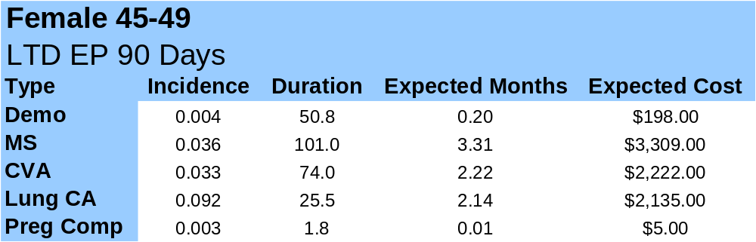
LTD Clinical vs. Demo Models—
Group Forecast Accuracy Improves due to Increased Precision at Person Level

Slide 9
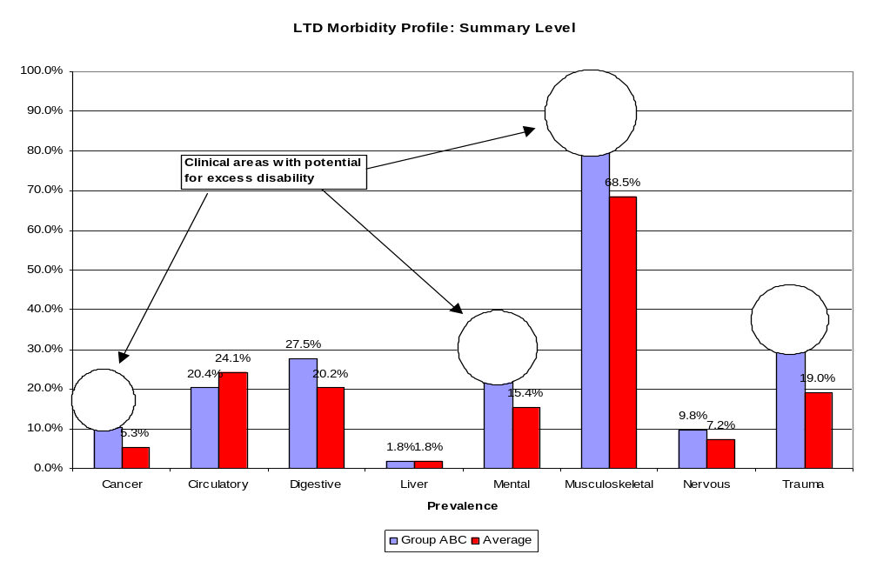
Example Clinical Profile for Underwriting and Medical Management

Slide 10
What Will This Do for Me?
Decrease loss ratios by using medical data to avoid groups with higher risk than indicated by demographics alone.
Increase close ratios on lower risk groups by applying discounts.

Slide 11
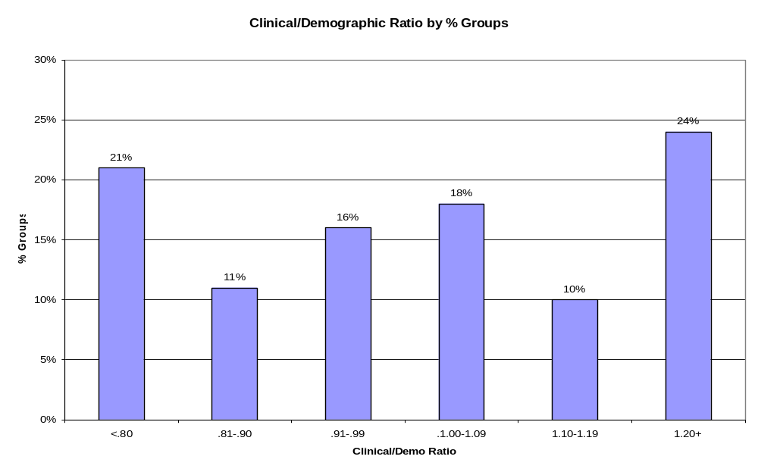
Group Level Clinical Risk— About 1/3 Groups 10%+ Over, 1/3 Groups 10%+ Under Demo Average

Slide 12
Potential Profit Impact LTD
Based on one client’s data for cases under 1,000 lives
  Avoiding the worst 5% of cases would result in increasing margins from 14% to 36%
Additional profit produced by targeting low clinical risk groups
  21% groups have clinical/demo ratio<.80
  10% premium reduction gives clinical loss ratio=(.8/.9)*(current loss ratio)=.89 or lower of current
10% reduction in loss ratio is target for LTD and Life

Slide 13
Summary
Medical plans will have large competitive advantage
  Superior risk selection using medical claims—competing group Life and LTD carriers will not have detailed medical information on each subscriber.
  Improve cross-sell from medical with quotes closer to the winning quote. As Life and LTD premiums are each about 3% of medical, packaged quotes that bundle multiple product lines should be easier to win.
High persistency rates favor incumbent

